Slide 1
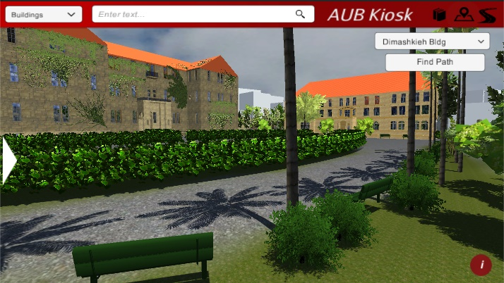
AUB Kiosk
Team Members: Sarah Fakhoury,
Samer AL Masri, Ines Badji.
Mentor: Dr. A. Dhaini

Slide 2
Project Aims
Build an interactive map for AUB
Make new students’ life easier inside and around campus
Help students find quiet and appropriate places to study

Slide 3
Technical Elements
Development Requirements:
Sketch Up
Unity
MySQL
Application Requirements:
Windows 7+
SQL Server
Sources Used:
AUBsis Webpages
Zomato.com Webpages
Stackoverflow

Slide 4
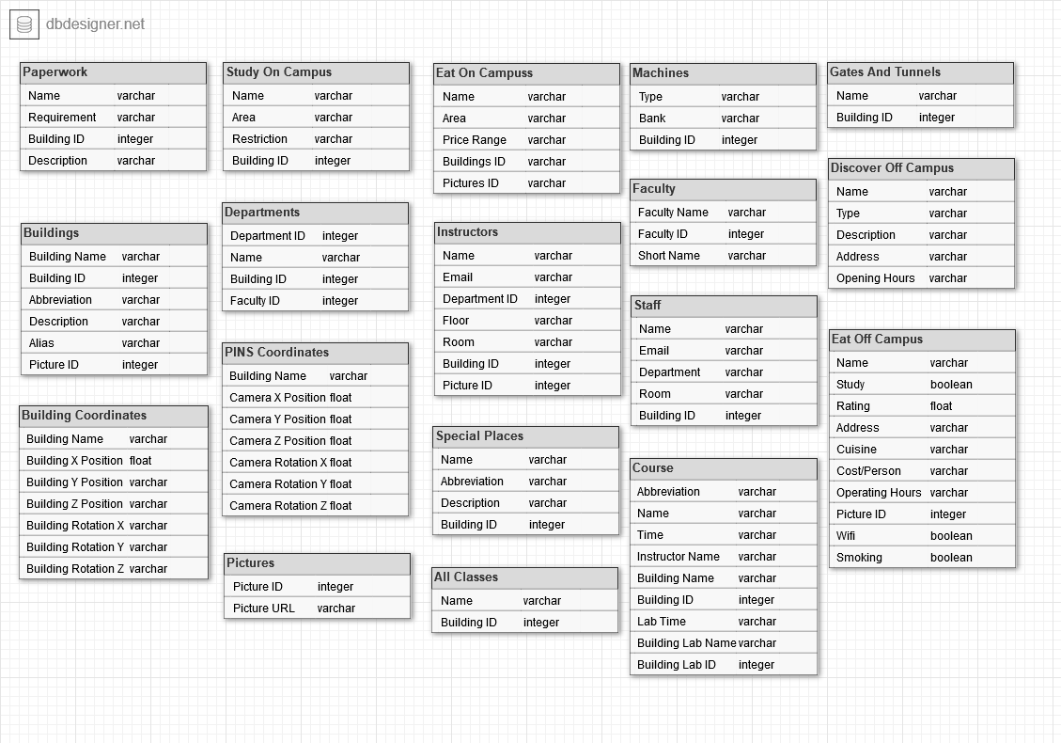
Database

Slide 5
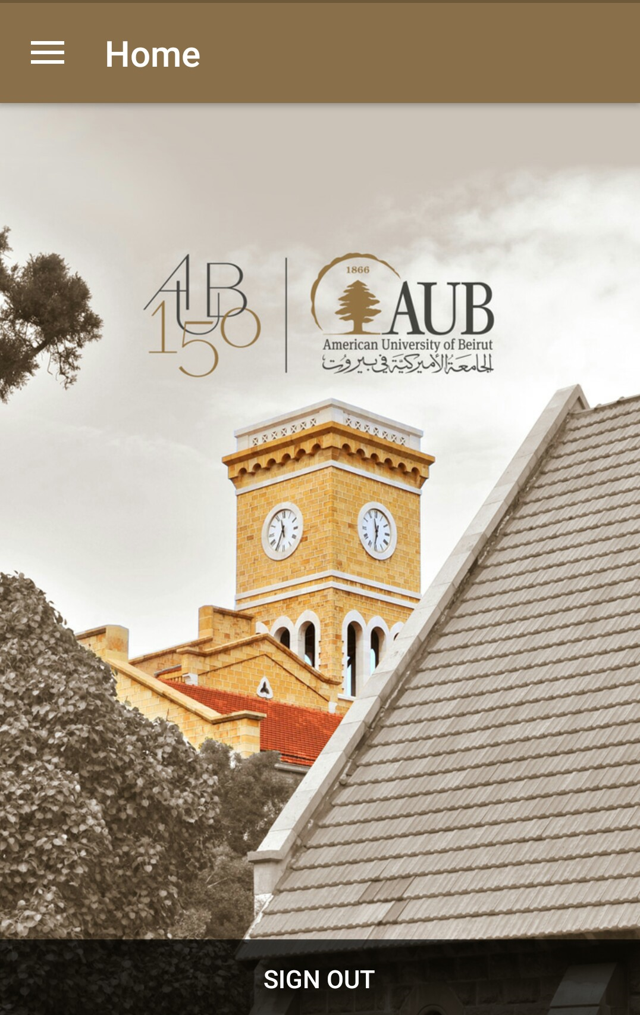


Evolution
Android Application
QGIS

Slide 6
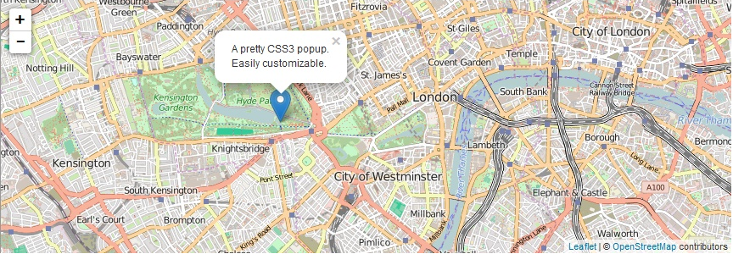
LeafletJS & MapBox

Slide 7
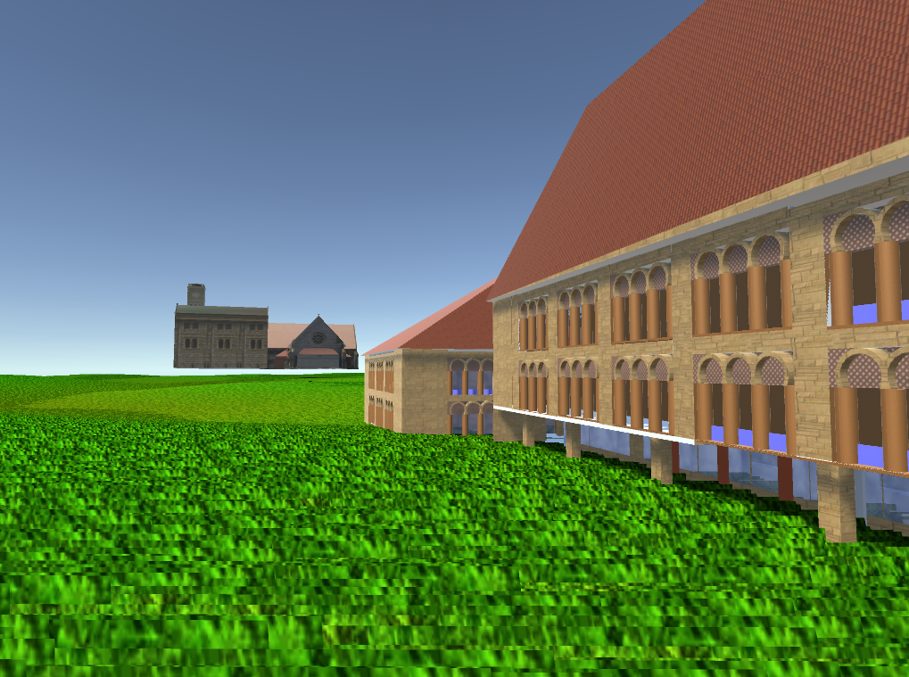
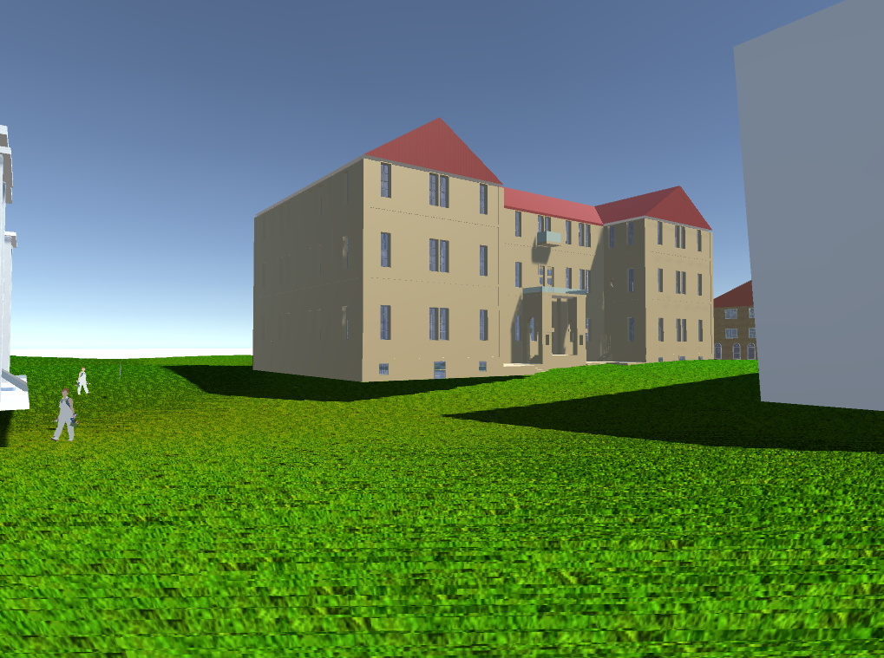
Unity
Hello Unity!
Notes:
Blender
Lights
Grass
Textures
Floating Buildings

Slide 8
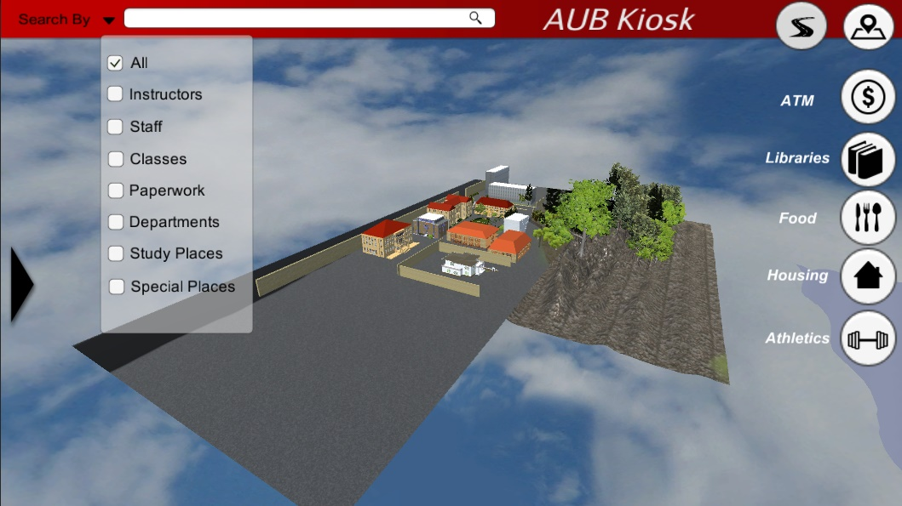
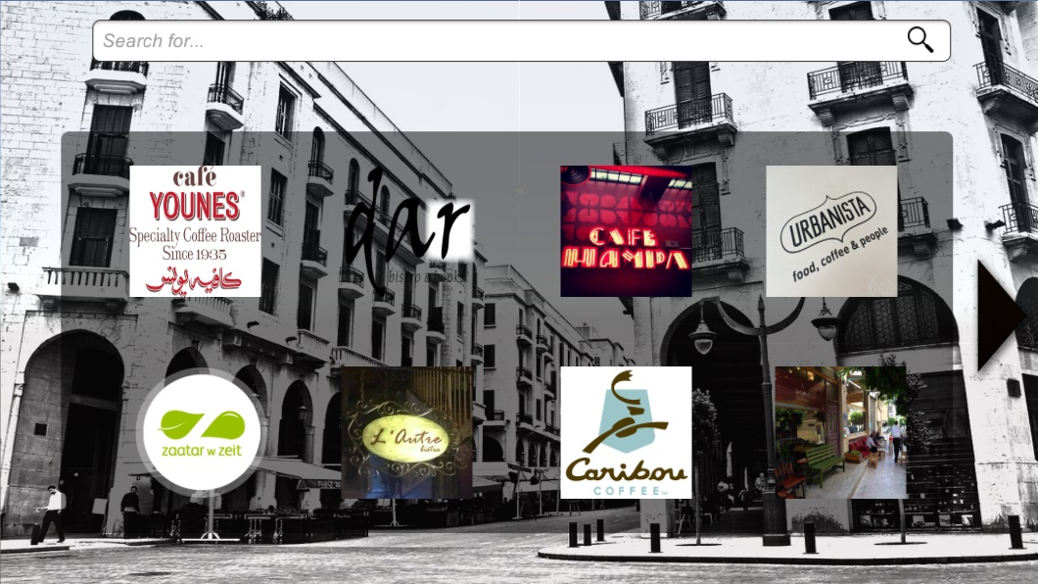
In March:
Notes:
Dimensions
Base maps
Basic Terrain
Off campus

Slide 9
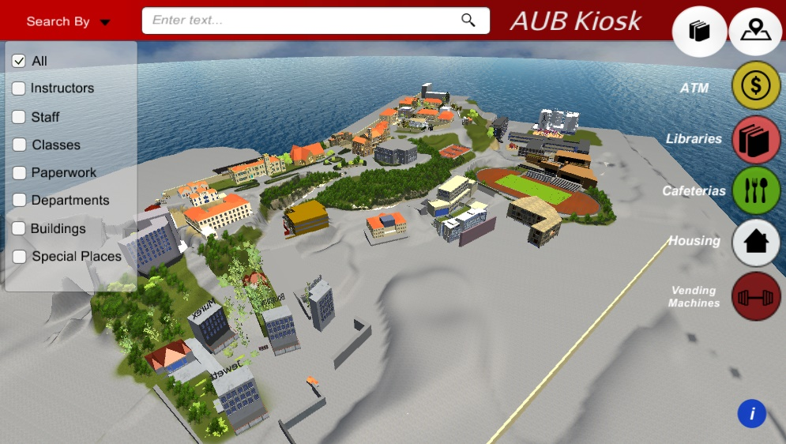
In April
Notes:
Planes
Ocean
Terrain
Pins

Slide 10
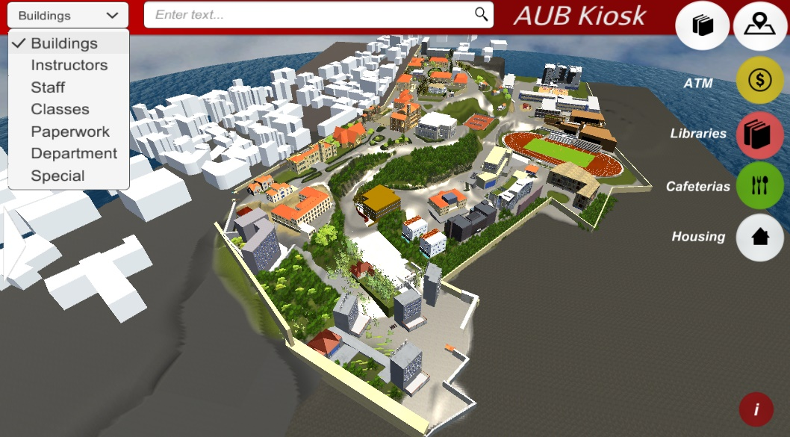
Beginning of May

Slide 11
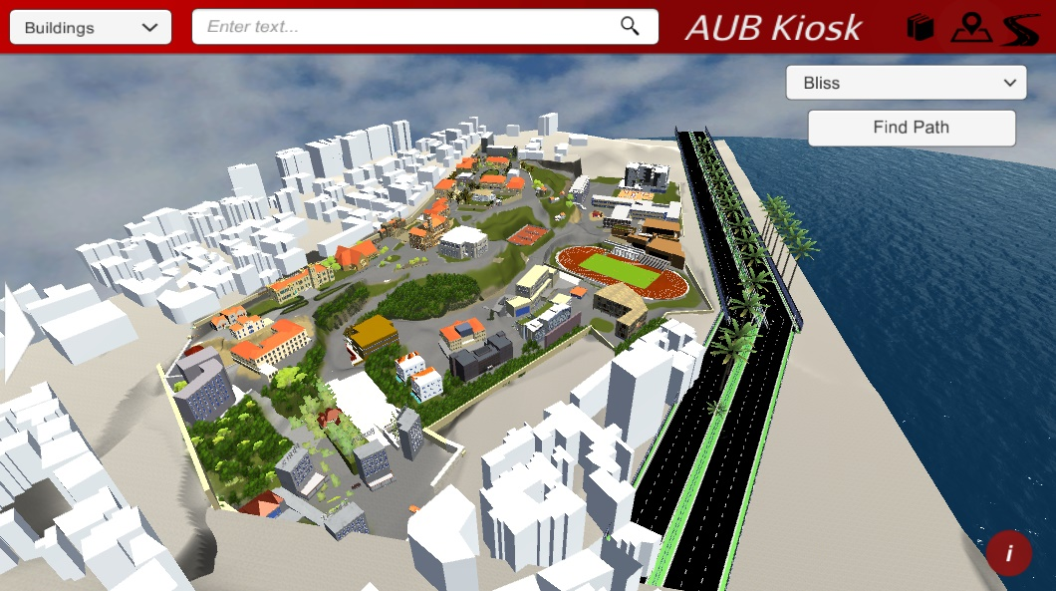
Outcome
Notes:
White off campus

